Slide 1
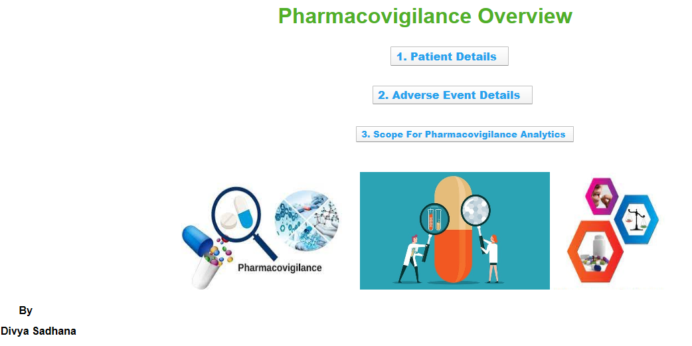
Home Page

Slide 2
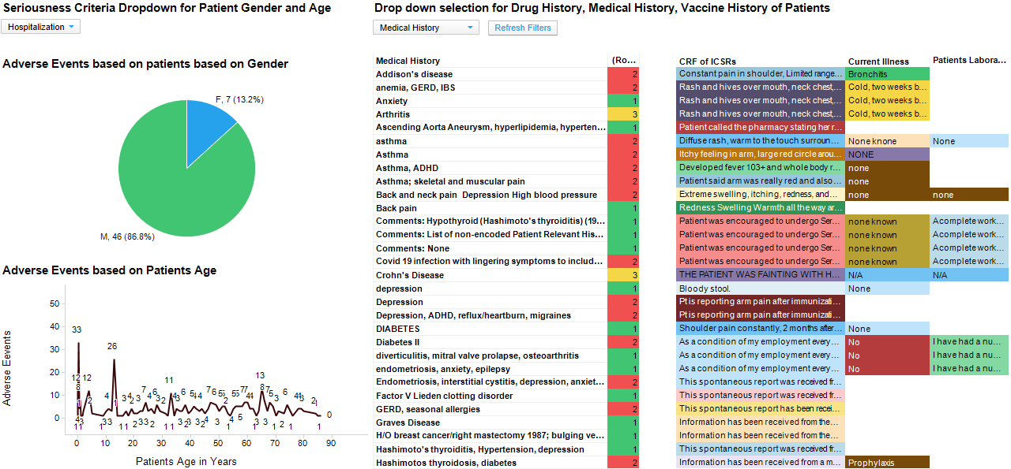
Patient Details

Slide 3
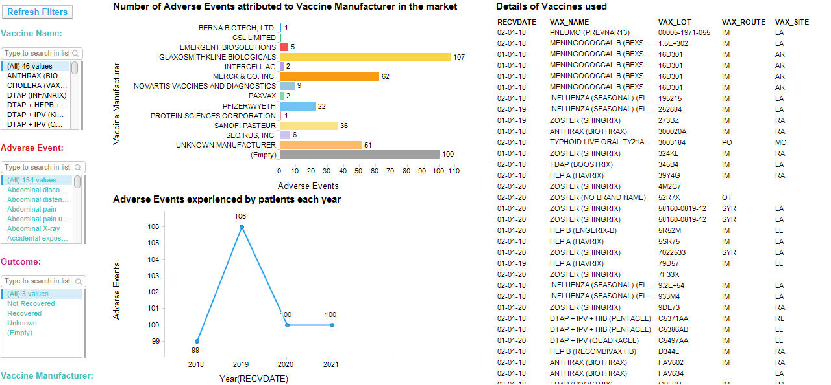
Adverse Event Details

Slide 4
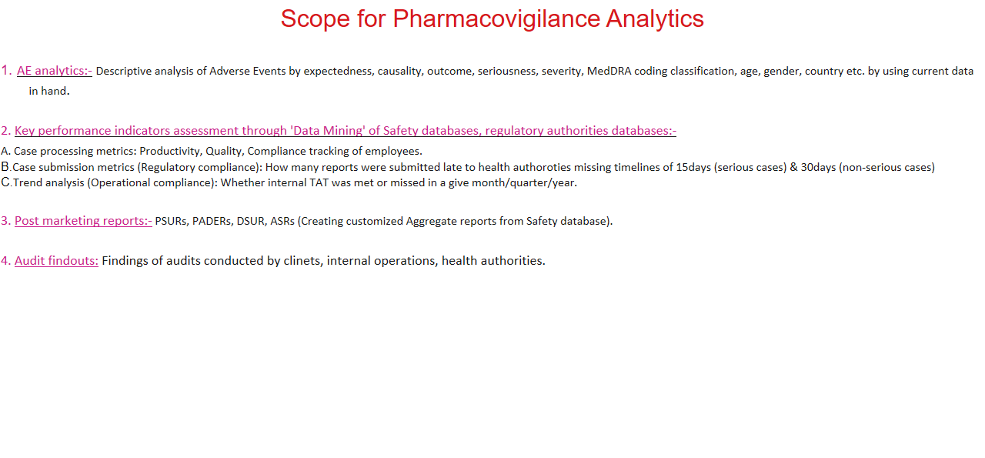
Scope For Pharmacovigilance Analytics

